Slide 1
Introduction to IT

Slide 2
Introductions
Name
Expectations for this course:

Slide 3
Materials
All student materials are provided in the student guide:
Slides and instructional text
Exercise worksheets
Pre-test, post-test, and answer key
If you are taking this class virtually, you will need a computer. However, for all students, a computer may be beneficial in completing some exercises.

Slide 4
Module 1: Software Development Life Cycle and the Characteristics of a Good Application

Slide 5
Opening
Connections and Predictions
Connection to Behavioral Skills and Mindsets
Objectives and Overview

Slide 6
Software Development Life Cycle and the Characteristics of a Good Application
After completing this module, students will be able to:
Explain the purpose of the Software Development Life Cycle (SDLC)
Examine an application to determine if it meets the criteria of a good quality application
Behavioral Skill: Communication Mindset: Growth Mindset
6

Slide 7
Software Development Life Cycle (SDLC)
The SDLC is repeated over the lifetime of an application; it’s used to create, update, fix, and maintain the application.
Each step in the cycle allows a company to focus on producing the best application possible.
Plan
Analyze
Design
Develop
Test
Implement
Maintain
Notes:
The 7 steps of the software development life cycle.
These steps will be covered in module 3. The quality of an application can only be as good as the process that created it. By introducing these concepts here, the students can recognize these steps are the process by which we implement the quality standards discussed in this module.

Slide 8
SDLC Models
There are different methods that are used within the SDLC. These methods are also know as Software Development Process Models. Below are a few industry standard models.
Waterfall
Iterative
Spiral
V-Model
Big Bang Model
Agile

Slide 9
Characteristics of a Good Quality Application
Functionality
Reliability
Usability
Efficiency
Maintainability
Portability
Notes:
As cited by ISO 9126-1

Slide 10
Characteristics of a Good Quality Application
Functionality
Reliability
Usability
Efficiency
Maintainability
Portability
Suitability
Interoperability
Security
Compliance
Maturity
Fault Tolerance
Recoverability
Understandability
Learnability
Operability
Attractiveness
Time Behavior
Resource Utilization
Analyzability
Changeability
Stability
Testability
Adaptability
Instability
Co-existence
Replaceability
Notes:
As cited by ISO 9126-1

Slide 11
Standards of Software Quality
There is an international organization that maintains standards for software quality.
International Organization for Standardization (ISO)
International Electrotechnical Commission (IEC)
Together ISO and IEC create international standards for electronic related technologies.

Slide 12




Functionality
Does the app fulfill the purpose it was designed for?
Modern applications have many distinct tasks that all need to work together in order to resolve a customer’s need.
Amazon.com uses many different systems together to help a customer:
Each of these systems are an important part of the Amazon.com experience.
Find which products are available for purchase.
Store a page for each product including available options, prices, and user reviews.
Secure payment processing to protect the customer during purchase.
Provide accurate shipping estimates to help customers receive products in a timely manner.

Slide 13

Check for Understanding
Reflect on the content just explored as a group.
Using your own words, how would you summarize the most crucial pieces of information?
How will you interact and engage with this content as a Cloud Support Engineer?
Which behavioral skills and mindsets will support your ability to effectively use this content as a Cloud Support Engineer?
Options to share: Written Response, Turn & Talk, Whole Class Debrief, Instructor Choice!

Slide 14
Functionality
Functionality
“A set of attributes that bear on the existence of a set of functions and their properties. The functions are those that satisfy stated or implied needs.” ISO/IEC 9126
Suitability
Interoperability
Security
Compliance

Slide 15
Functionality to Suitability
Suitability
How suitable is the application for a particular purpose.
Functionality

Slide 16
Functionality to Interoperability
Interoperability
How well does the application interact with designated systems.
Functionality

Slide 17
Functionality to Security
Security
How well does the application prevent unauthorized access, whether accidental or deliberate.
Functionality

Slide 18
Functionality to Compliance
Compliance
How well does the application adhere to regulations in laws and standards.
Functionality

Slide 19
Check for Understanding
Reflect on the content just explored as a group.
Using your own words, how would you summarize the most crucial pieces of information?
How will you interact and engage with this content as a Cloud Support Engineer?
Which behavioral skills and mindsets will support your ability to effectively use this content as a Cloud Support Engineer?
Options to share: Written Response, Turn & Talk, Whole Class Debrief, Instructor Choice!

Slide 20
Reliability
Reliability measures risk and likelihood of application failures. It also measures defects from modifications (stability).
The goal is to reduce and prevent downtime of the application.
An app that consistently locks up, crashes or freezes makes it difficult or impossible to complete a task.
Good architectural and coding practices are essential to mitigate most problems that can affect an application’s reliability.

Slide 21
Reliability
Reliability
"A set of attributes that bear on the capability of software to maintain its level of performance under stated conditions for a stated period of time.” ISO/IEC 9126
Maturity
Fault Tolerance
Recoverability

Slide 22
Reliability to Maturity
Maturity
How mature is the application when measured by the frequency of failures in the software.
Reliability

Slide 23
Reliability to Fault Tolerance
Fault Tolerance
How well can the application maintain a level of performance in case of failure.
Reliability

Slide 24
Reliability to Recoverability
Recoverability
How well does the application recover from a failure and reestablish performance.
Reliability

Slide 25
Check for Understanding
Reflect on the content just explored as a group.
Using your own words, how would you summarize the most crucial pieces of information?
How will you interact and engage with this content as a Cloud Support Engineer?
Which behavioral skills and mindsets will support your ability to effectively use this content as a Cloud Support Engineer?
Options to share: Written Response, Turn & Talk, Whole Class Debrief, Instructor Choice!

Slide 26
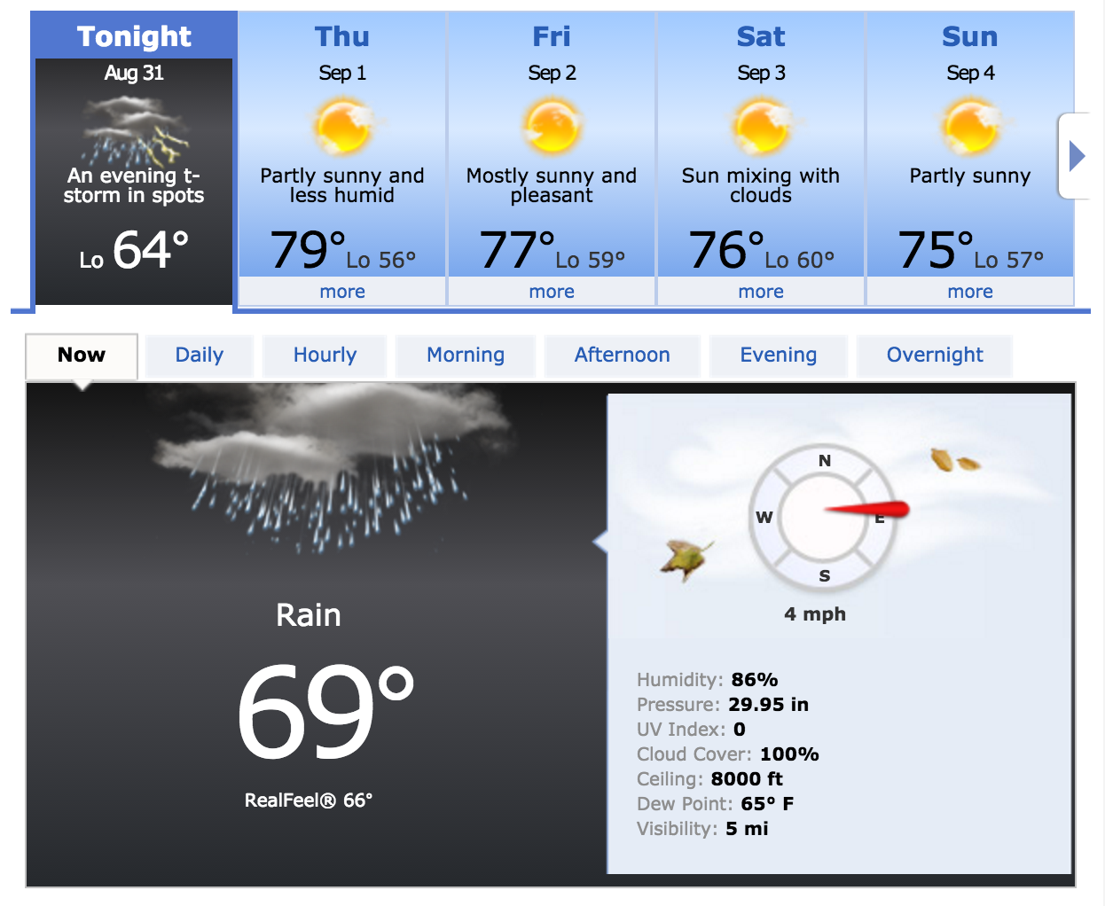
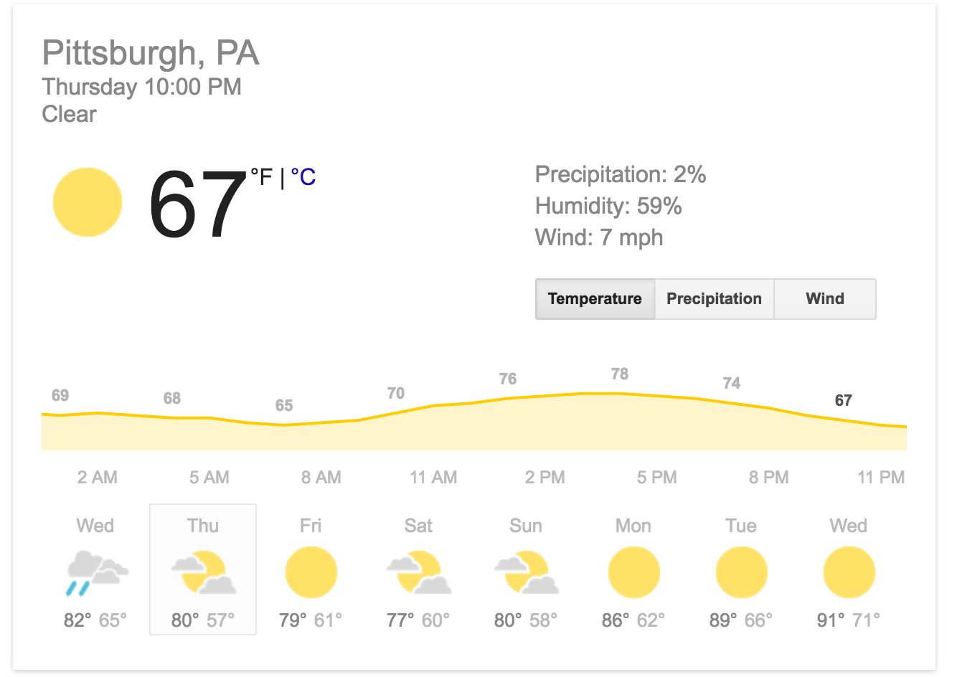
Usability
Is the application simple to understand and easy to use?
How intuitive and responsive is the user interface (UI)?
Which of these weather displays has better usability?

Slide 27
Usability
Usability
“A set of attributes that bear on the effort needed for use, and on the individual assessment of such use, by a stated or implied set of users.” ISO/IEC 9126
Understandability
Learnability
Operability
Attractiveness

Slide 28
Usability to Understandability
Understandability
How easily can the function of the application be understood.
Usability

Slide 29
Usability to Learnability
Learnability
How much effort does it take to learn the application for different users (novice, expert etc.)
Usability

Slide 30
Usability to Operability
Operability
How easily can the software be used by a given user in a given environment.
Usability

Slide 31
Usability to Attractiveness
Attractiveness
How easily can the software be used by a given user in a given environment.
Usability

Slide 32
Check for Understanding
Reflect on the content just explored as a group.
Using your own words, how would you summarize the most crucial pieces of information?
How will you interact and engage with this content as a Cloud Support Engineer?
Which behavioral skills and mindsets will support your ability to effectively use this content as a Cloud Support Engineer?
Options to share: Written Response, Turn & Talk, Whole Class Debrief, Instructor Choice!

Slide 33
Efficiency
Is the application able to work fast enough?
Does it take more resources to complete each task than it should?
Does the application slow down the device or use excessive amounts of power?
Efficiency is very important in areas where speed of execution matters, such as transactions.
The efficiency of an application is measured by checking and practicing good coding practices.

Slide 34
Efficiency
Efficiency
"A set of attributes that bear on the relationship between the level of performance of the software and the amount of resources used, under stated conditions.”
ISO/IEC 9126
Time Behavior
Resource Utilization

Slide 35
Efficiency to Time Behavior
Time Behavior
How much time does it take for the application to respond (ex. transaction times).
Efficiency

Slide 36
Efficiency to Resource Utilization
Resource Utilization
How much system resources are used (memory, CPU, hard drive, network).
Efficiency

Slide 37
Check for Understanding
Reflect on the content just explored as a group.
Using your own words, how would you summarize the most crucial pieces of information?
How will you interact and engage with this content as a Cloud Support Engineer?
Which behavioral skills and mindsets will support your ability to effectively use this content as a Cloud Support Engineer?
Options to share: Written Response, Turn & Talk, Whole Class Debrief, Instructor Choice!

Slide 38
Maintainability
If the application breaks, can we determine the problem and easily fix it?
Maintainability also includes ideas such as:
How modular or reusable are the components?
How easily are the components updated or changed?
How easily can a new team member be brought up to speed on the project?
Is the code clean, and easy to read?

Slide 39
Maintainability
Maintainability
“A set of attributes that bear on the effort needed to make specified modifications.”
Analyzability
Changeability
Stability
Testability

Slide 40
Maintainability to Analyzability
Analyzability
How easily can we identify the root cause of failure within the application.
Maintainability

Slide 41
Maintainability to Changeability
Changeability
How much effort does it take to change the system/application.
Maintainability

Slide 42
Maintainability to Stability
Stability
How sensitive is the application negative impacts of the system changing.
Maintainability

Slide 43
Maintainability to Testability
Testability
How much effort is required to verify/test an application change.
Maintainability

Slide 44
Check for Understanding
Reflect on the content just explored as a group.
Using your own words, how would you summarize the most crucial pieces of information?
How will you interact and engage with this content as a Cloud Support Engineer?
Which behavioral skills and mindsets will support your ability to effectively use this content as a Cloud Support Engineer?
Options to share: Written Response, Turn & Talk, Whole Class Debrief, Instructor Choice!

Slide 45
Portability
Portability is the how easily the application, or components of the application can be used in in different environments. When software with the same functionality is produced for several platforms, portability is a fundamental issue for cost reduction.
Examples are applications that are designed to run on multiple platforms such as Windows, Mac, Android phones vs iPad etc.

Slide 46
Portability
Portability
“A set of attributes that bear on the ability of software to be transferred from one environment to another.” ISO/IEC 912
Adaptability
Installability
Coexistence
Replaceability

Slide 47
Portability to Adaptability
Adaptability
How easily can the application change to new specs (hardware) or operating systems (Windows VS. Mac, etc.)
Portability

Slide 48
Portability to Installability
Installability
How much effort does it take to install the application.
Portability

Slide 49
Portability to Coexistence
Coexistence
How well does the application work along side other software in the same environment.
Portability

Slide 50
Portability to Replaceability
Replaceability
The ability to exchange different components of the application within specific environments.
Portability

Slide 51

Let’s Practice!
Your instructor will explain the following practice activity intended to solidify your understanding.
Be prepared to debrief the experience when the whole group comes back together!
Options for Practice: You Teach, Quiz a Friend, Pitch It, How May I Help You?, Instructor Choice!

Slide 52
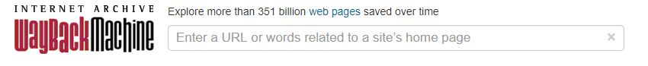
Activity
Open a web browser and go to amazon.com
Evaluate the home page for all the characteristics mentioned here:
Functionality, Reliability, Usability, Efficiency, Maintainability and Portability.
Open a new tab in that web browser and go to web.archive.org and in the main search box, type in amazon
From here, Choose a date approximately 2 years ago. Compare the two sites. How do they differ based on the above criteria? Now choose a date 10 years ago. How is this different?

Slide 53
Knowledge Check Questions
Is there a singular characteristic of a good quality application that would be more important than another? (Functionality, Reliability etc.)
True or False: Testability isn’t a part of a maintainable application.

Slide 54
Making Connections
Reflections
Connections to Behavioural Skills & Mindsets

